Slide 1
Budget Committee during 76th Executive Council
EC-76/Doc. 5 and EC-76/INF. 5
28 February 2023

Slide 2
Goal of Budget Working Group
Identify, from the EC-76 perspective, a consensus Maximum Expenditure level for 2024-2027
Propose updates to the Recommendation to Cg-19 on the level of Maximum Expenditures for 2024-2027 (EC-76/Doc. 5)
Provide guidance to the Secretariat on modifications to the issued INF document in line with the above

Slide 3
FINAC Report and EC Comments
SG’s Proposal was considered by FINAC as not affordable
Requested certain analyses (to be provided during Budget Committee/EC-76):
  Information by object of expenditure for the five major key deliverables funded in the SG’s Proposal
  Financial Implications of programmatic prioritization made based upon the Operating Plan
  Evolution of travel costs with particular emphasis on WMO Secretariat travel and
  Evolution of short-term staff and consultant costs
Adjust Operating Plan to identify (to be provided after EC-76):
  Milestones that could be delivered under ZNG scenario
  Discussion of what else could be delivered at the level of SG’s Funding or other scenarios

Slide 4
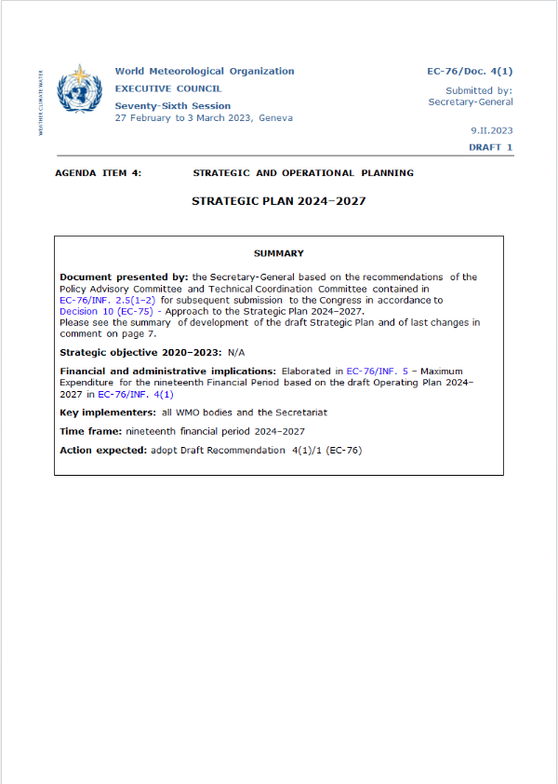
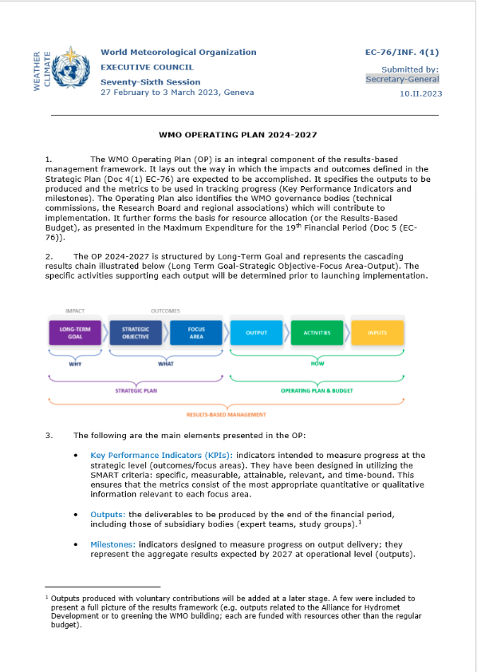
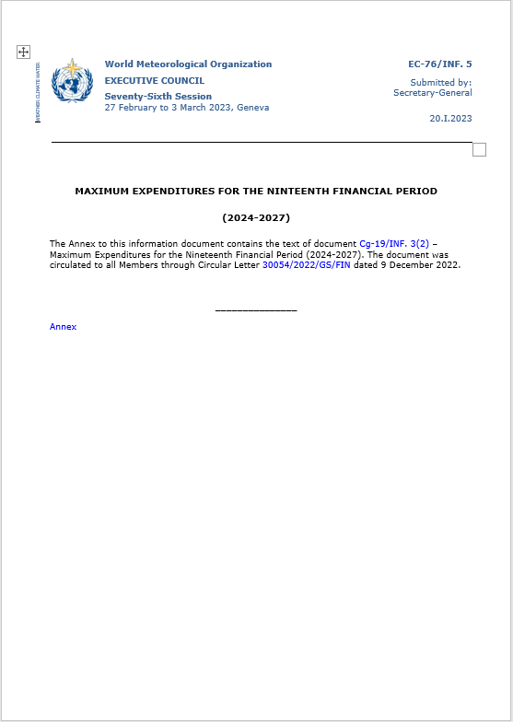
Alignment with the Strategic and Operating Plan
Strategic Plan 2024-2027
Operating Plan 2024-2027
Maximum Expenditures

Slide 5
Financial implications of programmatic prioritization

Slide 6
Financial implications of programmatic prioritization

Slide 7
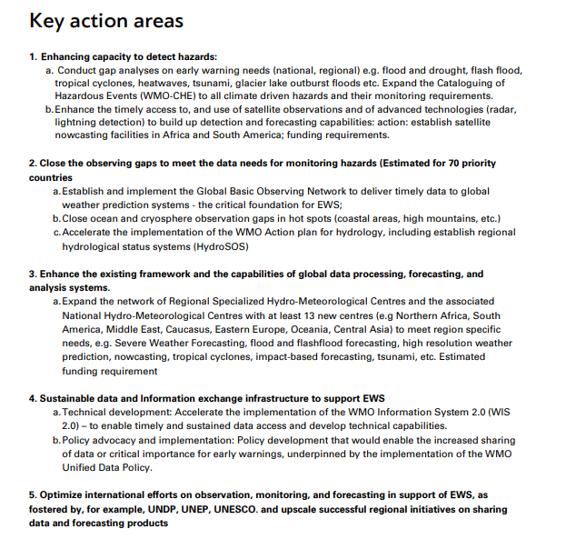
Early Warning Services - Additional under SG’s Proposal

Slide 8
Early Warning Services - Delivered under ZNG
MHEWS guidance and Cataloging of Severe weather, water and climate in English
Material developed for EWS available in English as base line
  Guides,
  Online IBF resources,
  CAP helpdesk
Expansion of WMO supportive frameworks with additional RSMCs or functionality: Multiple centers established with conservative hazard list
Modest expansion of the list of additional hazards supported by RSMCs, (e.g. heatwaves)
LDCs and SIDS are supported
Secretariat coordination and support prioritized
GBON implementation (supported by SOFF in LDCs and SIDS)

Slide 9
Early Warning Services - Additional under SG’s Proposal
Regional needs better covered by RSMCs
  Support to development of new centre designations and functions
  Tailored development with subregional approaches and additional hazards,
  Heatwave warnings established globally
Training material for IBF, CAP etc made available in multiple languages
  Increase capability of National users of warning information for optimizing usage of CAP messages across all media and down to community level
Improved access and capacity development for use of satellite data to support nowcasting in areas with limited in situ observations
Development of frameworks to support members in better use of products from global NWP centres and
More countries beyond LDCs and SIDSs are supported
Advance science and develop innovative methods to improve forecasts and
predictions at local/regional scale
Additional Secretariat coordination with partners and support to address upscaling and support to constituent bodies

Slide 10
Plan of Action for Hydrology
Within ZNG, funding for activities has been requested; however, the ZNG scenario does not include the funding for the 1 ½ staff positions required to implement the activities within the Financial Period. As Hydrological Action Plan approved by Cg-2021 would not be able to be implemented within the Financial Period.
Delivered under ZNG
Implementation of HydroSOS in limited countries – prioritization required (note it is a priority for RA and countries)
Fewer best practices investigated for implementation
Additional under SG’s Proposal
Global State of Water Resources Reports
HydroSOS implemented
Hydrological Action plan implementation as approved by Cg-2021 with required Secretariat support
Establishment of new WIPPS Centers on Hydrology
Increased outreach on added value of NHSs to support decision making
CoP established on hydrological issues (flood forecasting, water resources assessment etc.)
Capacity development through twinning and e-learning

Slide 11
Cryosphere and downstream impacts
Delivered under ZNG
Integration of Cryosphere activities in INFCOM and continued support to AG-Cryo
SO 1.5 cannot be implemented, cryosphere services not adequately reflected in WMO workplan
P&HM hazards partially included in EW4All
Limited, but insufficient progress on RCC in polar regions and approved WIPPS Centers on snow cover prediction
Additional under SG’s Proposal
Full implementation of SO1.5 as per 2024-2027 Strategy with Secretariat's support
Support to 2025 International Year on Glaciers Preservation
Increase Members’ ability to respond to emerging risks

Slide 12
Greenhouse Gas Monitoring Infrastructure
Delivered under ZNG
  Improved coordination of existing observation-based greenhouse gas monitoring efforts;
  Improved international exchange of data from existing GHG observing systems and networks;
Additional under SG’s Proposal
  Dedicated Secretariat staff providing leadership, coordination and external representation
  Leveraging of opportunities for development funding and private sector funding to further develop technology and expanding GHG observing networks for all domains;
  Consolidated design of an integrated global observing system (space- and surface-based, all domains) for GHG monitoring,
  Advancing assimilation methodologies to constrain concentrations and surface fluxes in support of providing source sink estimates
  Advancing methodologies for coupling of Earth system component models to account for fluxes between atmosphere, ocean and land surface
  Advancing the capabilities to ingest GHG and other atmospheric composition data in near real into earth-system model and assimilation capabilities

Slide 13
Regional Office Reform
Based upon the independent review report on the reorganization and optimization of the effectiveness of the WMO Regional and Representative Offices, the total cost of implementation of the recommendations would be in excess of CHF 11 million per Financial Period. Within the SG’s Proposal, a limited implementation is foreseen that would begin within the second biennium of the Financial Period.
Delivered under ZNG
Under ZNG, the status quo on staffing and location of Regional Offices would be maintained unless additional resources would be made available through extrabudgetary resources or if savings were identified.
Additional under SG’s Proposal
Under the SG’s Proposal, revised staffing of the Regional Offices would begin to be implemented in the 2026-2027 biennium on a phased basis. Full implementation would only occur subsequent to the EC’s consideration of the reform and agreement on staffing structures and office locations.

Slide 14
Regional Office Reform – within SG’s Proposal

Slide 15
Object of Expenditure for five major key deliverables
Moving from ZNG to Secretary-General’s Proposal:

Slide 16
Object of Expenditure for five major key deliverables
Total incremental EWS4A, including with ZNG and additional within Secretary-General’s Proposal:

Slide 17
Evolution of Travel Costs

Slide 18
Evolution of short-term staff and consultant costs

Slide 19
Basis for Inflation Estimates
Utilize International Monetary Fund (IMF) forecast:
IMF is internationally recognized
Utilizing forecast for all of Switzerland
Most recent update was published in October 2022
Long-term forecast, currently through 2027
IMF to update again in April 2023
Currently estimated to be just over 2% over the full financial period
Inflation has NOT been calculated on certain non-staff costs (e.g. repayment of the loan) as they are not impacted by inflation
Energy cost increase separately estimated
Based upon current futures markets data in Europe
Limited data beyond 2024
Potential for fluctuations between forecast and actual amounts

Slide 20
Inflationary Impact by Scenario
Component | Estimated Impact – SG’s Proposal | Estimated Impact – ZNG Scenario
Staff Cost Inflation | CHF 4.5 million | CHF 4.3 million
Non-Staff Cost Inflation | CHF 1.4 million | CHF 1.2 million
Energy Costs | CHF 0.9 million | CHF 0.9 million
Total Impact | CHF 6.8 million | CHF 6.4 million

Slide 21
Potential ZRG Scenarios
Element | Zero Real Growth (ZRG) Scenario
Maximum Expenditure at ZNG 2024-2027¹ | 271,544.4
Incremental EWS4A | 3,258.8
Incremental Hydrology Action Plan Implementation | 1,214.3
Unfunded ERP Implementation | 2,000.0
Additional programmatic priorities | 53.9
Maximum Expenditure Scenario 2024-2027 | 278,071.4
Resulting % | 2.4%
¹ Incorporates impact of inflation and efficiencies. Inflation at ZRG scenario is estimated at CHF 6,527.0.

Slide 22
Maximum Expenditures 2024-2027 – Draft EC Recommendation
Draft Recommendation 5/1 (EC-76)
Recommends to Congress the adoption of draft Resolution ##/1 (Cg-19) provided in the annex to the present Recommendation.
Annex to Draft Recommendation 5/1 (EC-76) – Draft Resolution ##/1 (Cg-19)
Authorizes the Executive Council during the nineteenth financial period from 1 January 2024 to 31 December 2027:
(1) To incur maximum expenditures of XXX XXX XXX Swiss francs [to be decided by Congress] to be funded through assessed contributions;
(2) To distribute the regular budget resources by appropriation part as provided in the annex to this resolution;
(3) To approve the biennial appropriations for 2024–2025 and for 2026–2027 within these limits;
Further authorizes the Executive Council to incur other expenditure from voluntary resources contributing to enhanced implementation of programme activities in line with the Strategic Plan, including co-sponsored programmes and initiatives;
Requests the Secretary-General to monitor the implementation of the Operating Plan at both the outcome and output levels, in accordance with the WMO monitoring and evaluation system, in particular in relation to the use of budgetary resources;
Invites Members to consider contributing voluntary resources to accelerate, expand and/or scale up the implementation of the Long-term Goals and Strategic Objectives of the Strategic Plan for 2024–2027.

